Slide 1
The effects of coloniality on ‘our’ collective psyche: how the postcolonial Nigerian education system struggles to deal with an alternative knowledge system
By
Hadiza Kere Abdulrahman PhD
@dj_kere
hadizaabdulrahman@yahoo.com

Slide 2
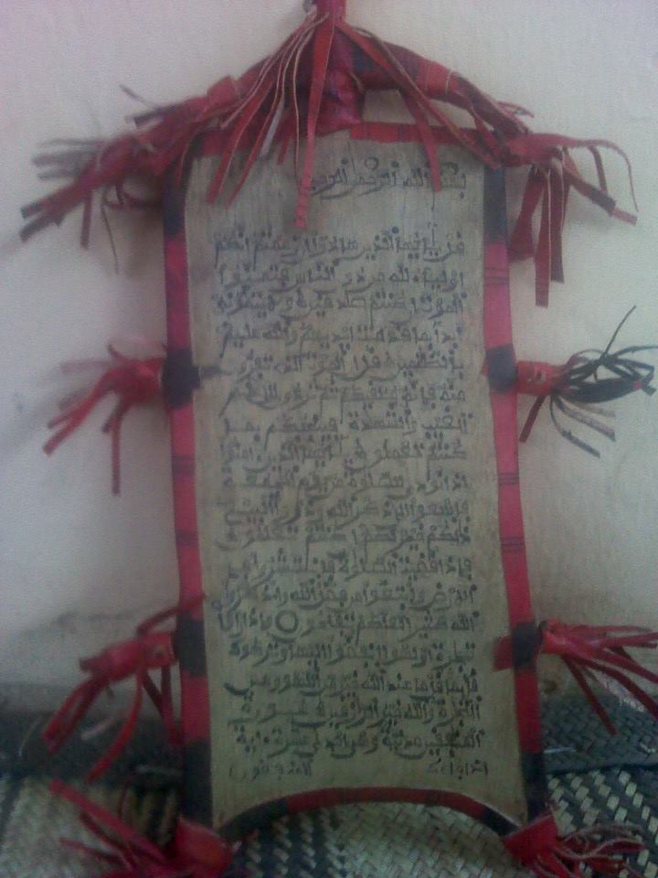
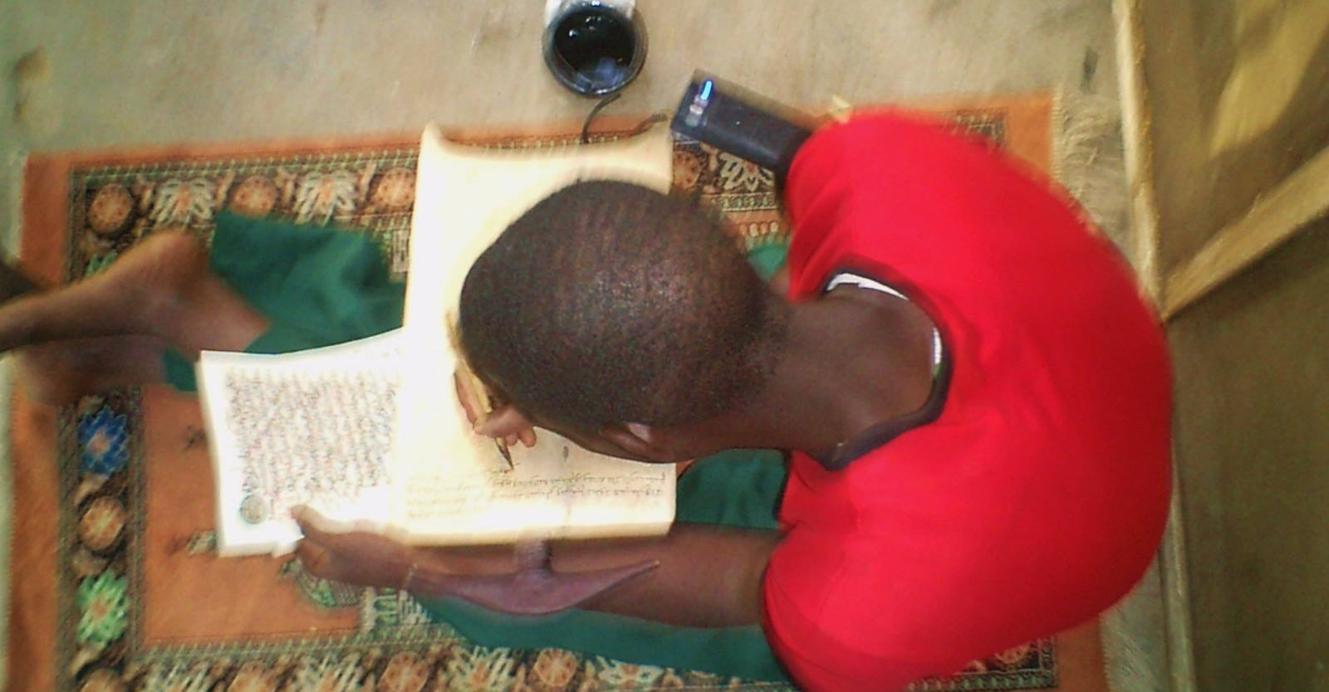
What is this alternative knowledge system?
Almajiranci - a classical system of Qur’anic schooling in northern Nigeria
Comes with several social concerns – estimated 8 to 10 million boys considered ’out of school’
Topic of great debate within the Nigerian society
Debate largely driven by ‘Western-educated’ Nigerians
Has struggled to find a place within the postcolonial Nigerian education system

Slide 3
Some housekeeping!
‘Western education’ as employed here – is secular and based on Anglo-European epistemology, inherited through the colonial project and commonly understood to be modern and progressive in Nigeria
Coloniality in this case – refers to the living legacy of colonialism in contemporary societies (often in the form of social discriminations). It also revolves around cultural systems that enforce Euro-centric norms, economic and knowledge production systems (Quijano, 2007; Grosfoguel in Ndlovu-Gatsheni, 2013)
Concept of coloniality is different from colonialism, it refers to the long standing patterns of power that emerged from colonialism. It is hidden in discourses, books, culture, common sense and even self-images of Africans (Maldonado Torres, 2007)

Slide 4
My research…..
Is a study of the graduates – Men who have been educated in this classical Qur’anic system of education
Uses the stories and life experiences of the men and juxtaposes it against elite representations of the system – mainly by ‘Western-educated’ Nigerians
Reveals various meanings of this system of knowledge amongst various groups
Uncovers a complex world of relational learning and alternative notions of education and socialisation
Ends up telling us something about the effects of coloniality on our collective psyche (as a people)

Slide 5
The existing representational discourses
A particular way of referring to the Almajiranci system and its practitioners
My study disaggregated these ‘Discourses’ into three major categories
1. Almajiranci as a ‘backward’ and retrograde system of education
2. Almajiranci producing dysfunctional adults – especially with the current Boko Haram crisis.
3. Almajiranci as a matter of children’s rights concerns

Slide 6
Examples of these discourses
‘Boko Haram, an advanced Almajiri’ – Sahara Reporters.
‘Nigeria’s Almajiri children, learning a life of poverty and violence’ – CNN.
‘The Almajiri: Abused, neglected’ – The Guardian, Nigeria.
‘Nigeria’s Almajiri schools: recruitment ground for terrorists?’ – DW.com
These narratives can also be found in academic literature:
Link between Almajiranci and non-state terrorism – Awofeso et al, 2001.
Describing theirs as a ‘lumpen childhood’ – Jimoh, 2008.
Described as ‘feral youth’ – Aluaigba, 2013.
A system devoid of values – Adetoro, 2010.
Almajirai as instruments of violence – Elechi & Yekorogha, 2013.

Slide 7
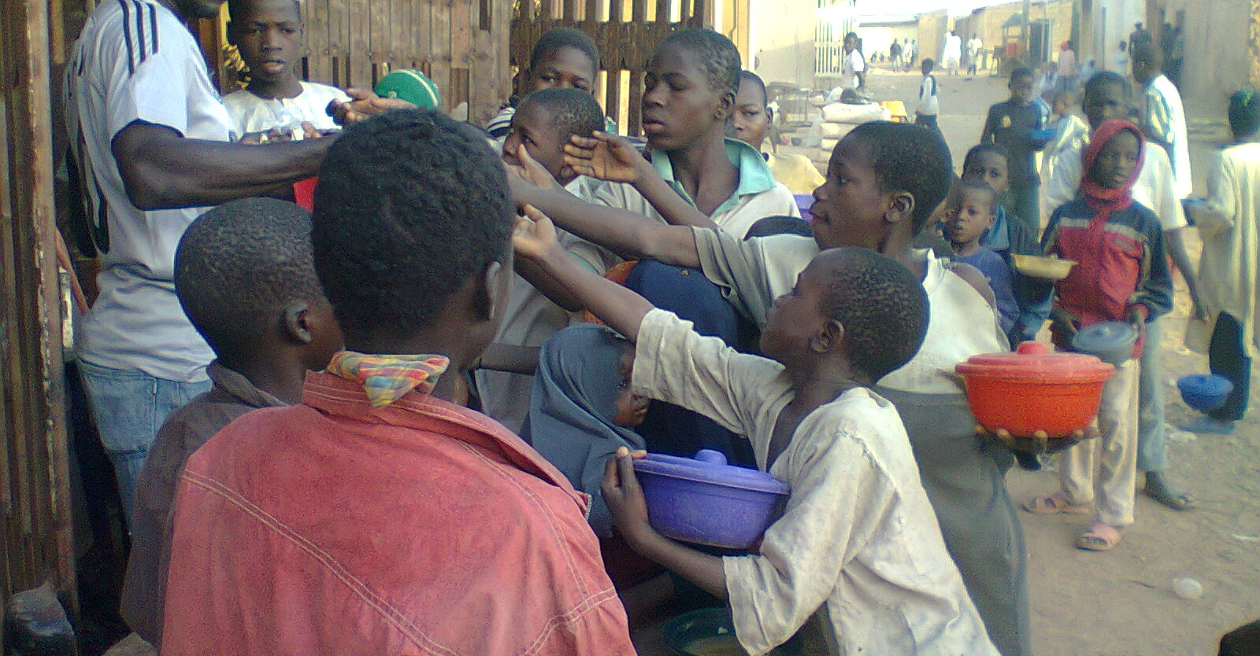
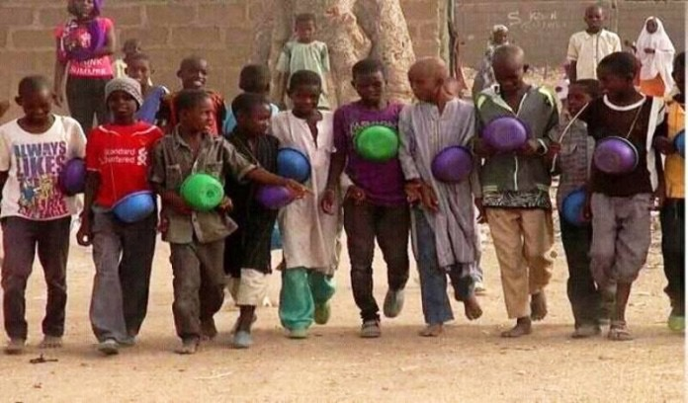
Common images of young almajirai sourced from the Internet
Notes:
Stereotypical images exist as representations of the Other, removed from the realities of Western-educated Nigerians except as encountered through our superior gazes

Slide 8
The study…..
Problematises the existing mainstream representational discourses of this ‘Other’ form of knowledge
Acknowledges the Politics of Knowledge and especially its relationship to identity formation and the representation of self and others
Examines the relationship between knowledge and power
Uses the Circuit of Culture (du Gay et al, 1997), to explore the way meaning is made and reinforced through shared conceptual frameworks in social practice
Reviews the effects of Coloniality on the Nigerian educational and social systems and how this can manifest as epistemological prejudice
Notes:
Trained in the colonial legacy to Other
Uses the circuit in order to understand how the discourses operate and influence representation

Slide 9
How it does this……
Uses the ‘Circuit of Culture’ as a discursive and analytical tool
Notes:
Giving and taking of meaning between members of a society or group operates as a circuit
Each moment provides an opportunity for reflection, to allow for contextual understanding of complexities, contradictions, ambiguities e.t.c

Slide 10
The role of Representation in postcolonial studies
Postcolonial scholarship is informed by theories that elucidate the politics of representation – think Said’s ‘Orientalism’ and Spivak’s ‘can the subaltern speak’
Politics of representation revolves around issues of power and control over one’s own self and its representation and reproduction by others, power relations embedded in who represents what
Hall (1997) says we give things meaning by how we represent them, cultural representations help form images people have of others, they also get embodied in institutions and inform policies and practices
Notes:
Identity depends on difference for its construction

Slide 11
Table contrasting meanings
The processes. | ‘Western-educated’ Nigerians. | Practitioners of Almajiranci.
Production | Through the dominant discourses in the form of media texts and scholarly publications, that pathologise the system and its practitioners. | ‘Alternative narratives’ of the system as valuable, and a worthy producer of a particular kind of Muslim. Through word of mouth and continued practice of sending boys to the schools.
Consumption | By people who are Western-schooled and can access, read and understand the shared meaning of the texts and images conveyed through the dominant discourses. | By the Arewa masses who still see its value and continue to send their children, especially at the grassroots level. ‘Value’ that is consumed as hope, prayers and self-affirmation.
Regulation | Through policy formation and everyday treatment of Almajirai, through or because of the material produced above. Material that also governs how the system can be spoken or written about. | Through the power that the Malamai wield in their communities of influence by their ‘acts of Malamta’, and the social recognition and relevance that this affords them.
Representation | Of the boys as beggars, men as Boko-Haram and other such mal-adjusted adults, through the discourses as texts and images. | Of the boys as seekers of knowledge and the men as scholars. Also as men who are pious Muslims and virtuous human beings.
Identity | ‘Othered’ and marginalised – seen through a lens of dysfunctionality. | Noble men, as illustrated by the Almajiri Character Framework. Men who identify with a certain set of values and ideals.

Slide 12
What the study finds…
a ‘relational’ system of knowledge and a complex and nuanced system of socialisation
Theoretical implication is that, what is regarded as constituted knowledge of Almajiranci is really only one set of possible articulation and alternative meanings exist
Reveals how emotional investments in certain knowledges, ways of knowing, power structures and identities are insidiously woven in everyday fabric of common sense (Boler, 1999 in Amsler, 2015)
Shows how schools and schooling can have different meanings in different contexts

Slide 13
In conclusion….
This talk is really a call for us to analyse the subject positions from which we speak, to situate ourselves vis-à-vis not only our research but also our praxis, Hall (2013) says we all write and speak from a particular place and time, Brenner (2001) adds that the ‘episteme’ of a time and place shapes discourse
Remember that we are probably all still struggling with the effects of coloniality – often insidious, through representation of self and others – Quote Abiola Irele (1991)
Representations are powerful, they become internalised and have deep and lasting material consequences expressed economically, socially and politically
Notes:
Episteme, like a world view or implicit set of relations that unite the discursive practice of a particular period
‘The west has exerted so much pressure on the African experience to the extent that it is no exaggeration to say that all forms of modern African expression have been conditioned by it’

Slide 14
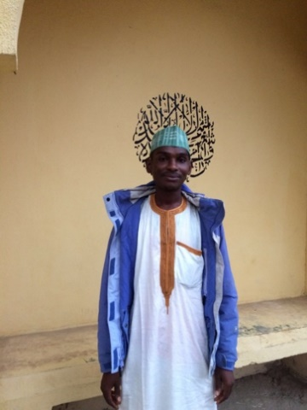
Malam Mustafa Abubakar

Slide 15
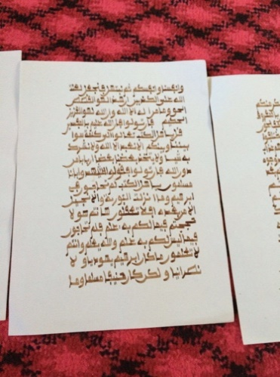
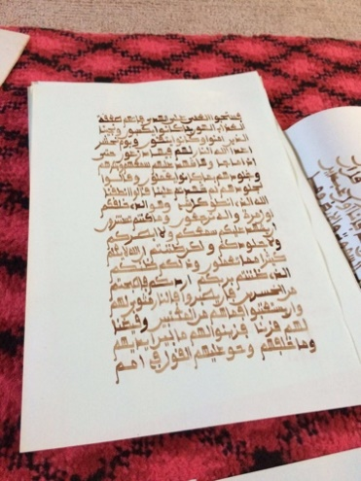
Handwritten copy of the holy Qur’an

Slide 16

Thank you for your time

